Slide 1
DNA Sequence Analysis Tool using Boyer–Moore String Matching Algorithm
2520030575 - M.LIKHITHA
2520030022 - AVSNR AKHILA
2520030198 - K. VAISHNAVI

Slide 2
ABSTRACT
GeneScan is a DNA Sequence Analysis Tool developed using the Boyer–Moore String Matching Algorithm to efficiently search for specific DNA patterns or gene motifs. The system allows users to upload DNA sequences and search for desired patterns within them. It identifies and highlights matching regions while displaying the search time and number of character comparisons. GeneScan shows how advanced DSA string-matching techniques can be applied to real-world areas such as bioinformatics, genetics, and medical research.

Slide 3
PROBLEM STATEMENT
DNA sequences are very large, making it difficult and time-consuming to search for specific gene patterns using traditional methods. This project aims to develop a DNA Sequence Analysis Tool using the Boyer–Moore String Matching Algorithm to efficiently search for DNA motifs and display the results with improved speed and accuracy.

Slide 4
PROPOSED FUNCTIONALITIES
DNA Sequence Input – Enter a DNA sequence using A, T, G, and C.
Pattern Input – Enter the DNA pattern to be searched.
Pattern Searching – Use the Boyer–Moore algorithm to search the pattern efficiently.
Find All Matches – Display all positions where the pattern occurs.
Sequence Validation – Check whether the DNA sequence contains only valid bases.
Result Display – Show whether the pattern was found and display the matching

Slide 5
TOOLS AND TECHNOLOGIES TO BE USED
Programming Language :Java – Implementation of Boyer–Moore Core Algorithm : Boyer–Moore String Matching
File Handling : FASTA / TXT – DNA sequence input
Data Structures : Arrays / Strings – DNA sequences and pattern processing
Frontend / User Interface : HTML, CSS, JavaScript – User interface and result visualization
Development Tools : VS Code / IntelliJ IDEA – Code development
  Git & GitHub – Version control and project management

Slide 6
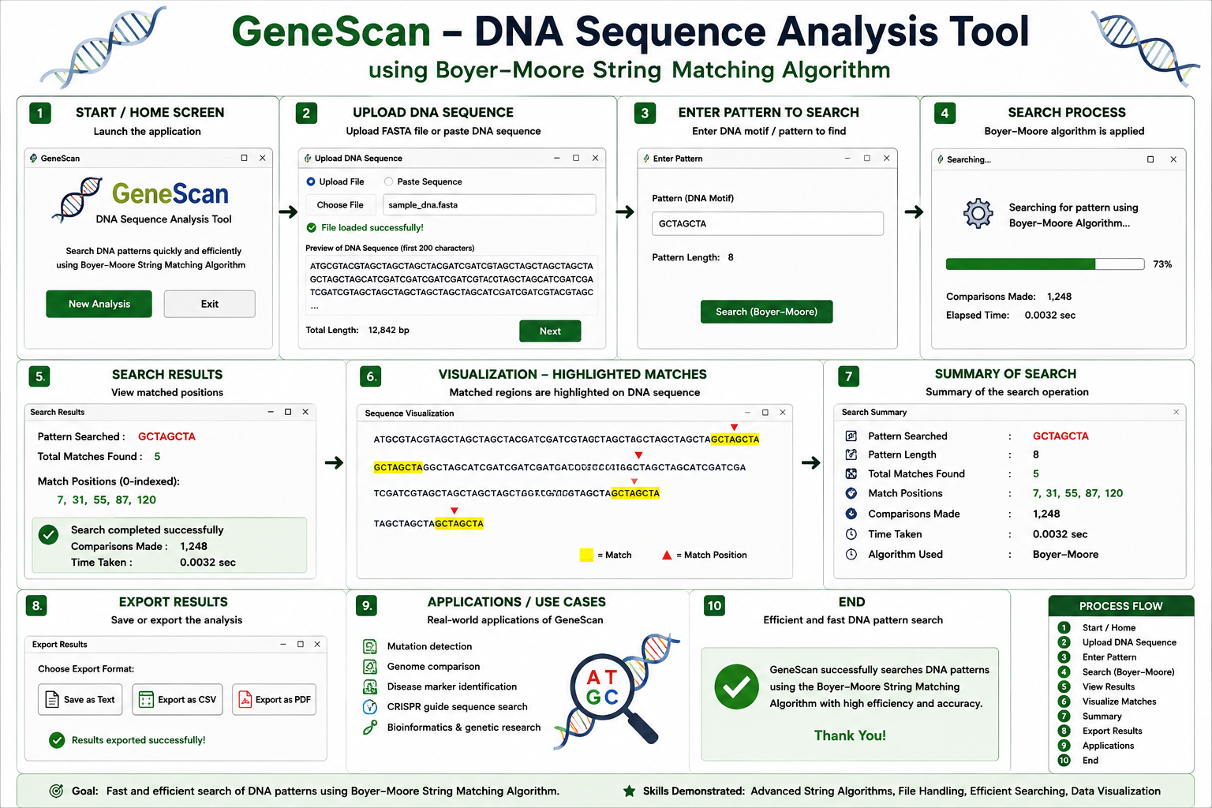
DEMO

Slide 7
OUTCOME
~ Quickly finds specific DNA and gene patterns using the Boyer–Moore algorithm.
Identifies matching positions and helps detect important DNA patterns such as mutations and disease markers.
~ Compares Boyer–Moore with Naïve String Matching to show search efficiency.
~ Can be used in genome comparison, CRISPR sequence searching, and genetic research.
~ Demonstrates how DSA and string-matching techniques can be applied to real-world bioinformatics problems.

Slide 8
Thank You

